Slide 1

Learning objectives
By the end of this class, when doing gap-filling tasks, you will be able to
1. Apply approaches based on clues and text awareness.
2. Analyze the structure and flow of both the passage and paragraph.
3. Confirm the best options with text analysis.

Slide 2

How to complete a gap-filling task
---based on discourse awareness
Logic
Structure
Discourse
Notes:
更多模板请关注：https://haosc.taobao.com

Slide 3
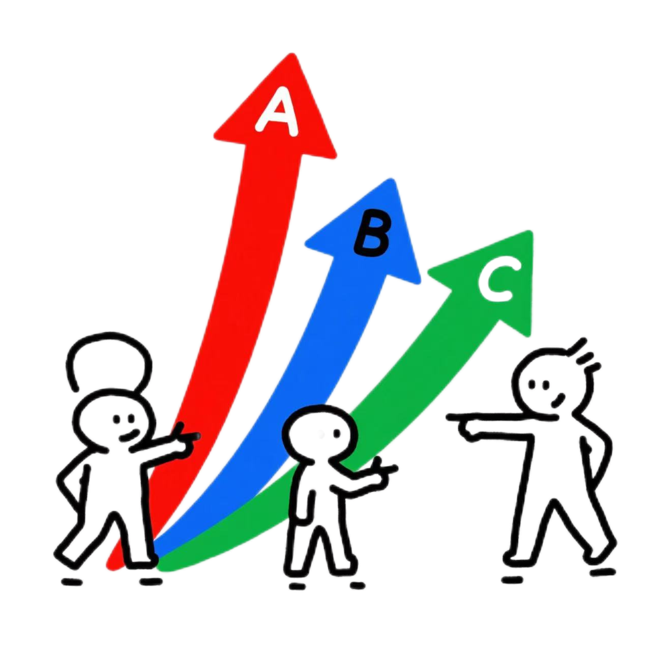
Review-Homework
2025年新课标Ⅰ卷
36. E 37. D 38. C 39.F 40. G
2026年1月浙江首考
36. B 37. E 38. C 39. F 40. G
How can we improve accuracy?
Notes:
提前把答案写到白板上

Slide 4

Part1 Improve accuracy-self reflection
2025年新课标Ⅰ卷 Q36
An Unsung Hero
① Need a break between classes or just a quick pick-me-up in the morning? The College Cafe has just that, and more. 36
How did you make the wrong choice?
A. The cafe closes at 9 pm every day.
E. Not only does this cafe serve up drinks, it also serves up smiles.
A×
Clue 1:
Repeated Words
Notes:
数据 – 核心问题 – 缺乏对语篇的关注的问题 – AI提出重点 – 总结策略 –
分析structure and flow 和其他的
一个整篇做
让AI再来讲一下 其中一个题 看看谁讲得更好

Slide 5
Part1 Improve accuracy-self reflection
2026年1月浙江首考 Q36 Q37
① During your initial reading of material, do you ever go back and reread sentences or paragraphs? Is it because the material is too difficult to comprehend on the first reading or because you are asleep? 36 You are napping (打盹) or daydreaming. Halfway down the page you realize that you have no idea what you have read. 37 Thus, you go back and reread, not because you did not understand, but because you were not paying attention. This type of rereading is called regression.
A. Both are to blame.
B. Probably the latter is true.
C. Don’t just read the words; think the ideas.
E. Your eyes were engaged, but your mind was not.
Clue 3:
Logical Indicators
B√
A×
Clue 2:
Pronoun reference
C×
What does “the latter” refer to?
此句与后句无因果关系
Notes:
数据 – 核心问题 – 缺乏对语篇的关注的问题 – AI提出重点 – 总结策略 –
分析structure and flow 和其他的
一个整篇做
让AI再来讲一下 其中一个题 看看谁讲得更好

Slide 6

Part1 Improve accuracy-self reflection
Blanks scan
You can’t always get the right answer.
Clues search
Options comparison
A Clue-based Approach
Choice made

Slide 7
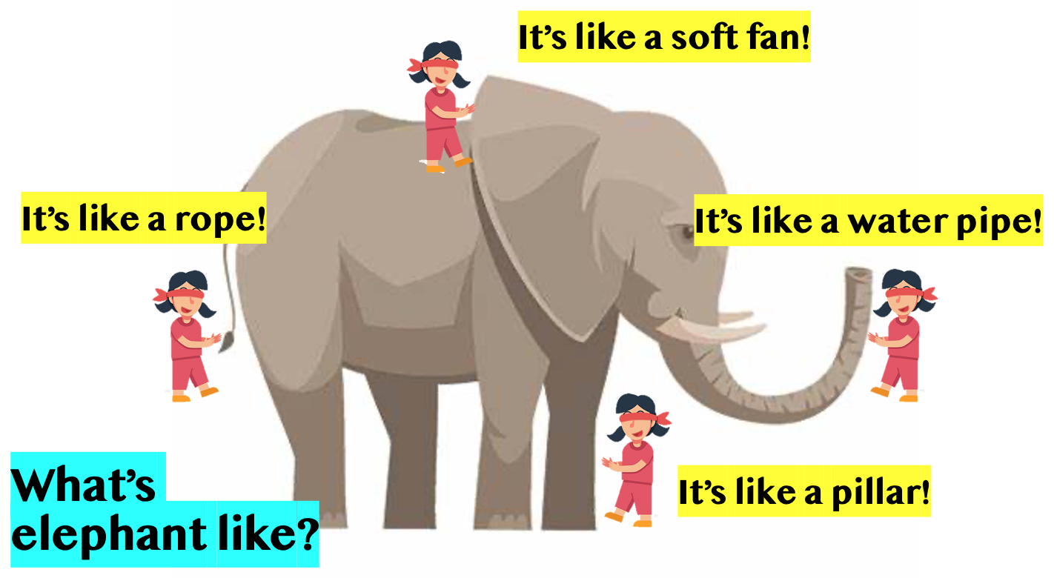
Part1 Improve accuracy
You only notice some parts of the text.
A Chinese Ancient Fable:
盲人摸象 Blind Men and an Elephant
You don’t know the text as a whole.
And you only get an incomplete understanding.
Notes:
前面引入需要简化

Slide 8



Part1 Improve accuracy
考试说明
Discourse(语篇)
考查目的：阅读理解“七选五”题型主要考查考生对文章的整体内容、结构及上下文逻辑意义的理解和掌握。
structure
content
logic
Discourse/Text awareness
(语篇意识)

Slide 9
Part1 Improve accuracy
Review on Text Flow
Flow is how sentences are connected coherently(连贯地).
There are many different ways to connect sentences together.
Grammar Connections
Pronoun Reference
代词指代
Subject & Tense Agreement
人称时态一致
Sentence Structure Agreement
句式一致
......
Words Connections
Repetition同词
Synonym近义词
Antonym反义词
Hyponymy
上下义词
Logical Connections
General-Specific
总分
Parallelism并列
Evidence例证
Cause & Effect
因果
Comparison & Contrast
比较对比
......

Slide 10
Part1 Improve accuracy
Passage Structure
Blanks scan
An Approach based on Text Awareness
Paragraph Structure
Clues search
Flow Analysis
Options comparison
Blank Prediction
Choice made
A Clue-based Approach
Option Comparison
Choice Made

Slide 11
Part2 An Approach based on Text Awareness
2025年新课标Ⅰ卷 Q36 Q37
An Unsung Hero
① Need a break between classes or just a quick pick-me-up in the morning? The College Cafe has just that, and more. 36
② Catherine Murphy, a cafe worker in a green shirt and black hat, makes sure that each customer gets exactly what they order. She goes back and forth between machines to make the drinks. 37 As the customer grabs the drink from her hand, she smiles and says, “Hello, how is your day?” Even when the line is getting longer, she doesn’t let it get in the way of her genuine conversations.
Notes:
数据 – 核心问题 – 缺乏对语篇的关注的问题 – AI提出重点 – 总结策略 –
分析structure and flow 和其他的
一个整篇做
让AI再来讲一下 其中一个题 看看谁讲得更好

Slide 12
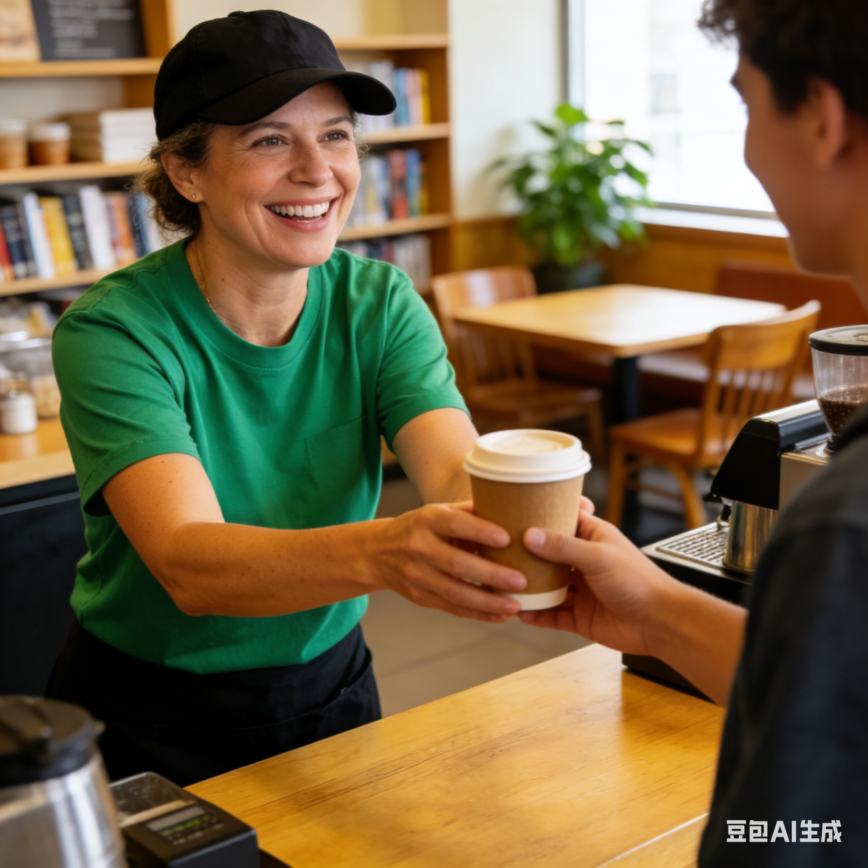
2025年新课标Ⅰ卷
An Unsung Hero
① Need a break between classes or just a quick pick-me-up in the morning? The College Cafe has just that, and more. 36
② Catherine Murphy, a cafe worker in a green shirt and black hat, makes sure that each customer gets exactly what they order. She goes back and forth between machines to make the drinks. 37 As the customer grabs the drink from her hand, she smiles and says, “Hello, how is your day?” Even when the line is getting longer, she doesn’t let it get in the way of her genuine conversations.
③ Murphy gets up at a quarter to five and drives thirty minutes every day to get to work on time. 38 “I do so because I like to make coffee for the students. I know they need it in the morning,” Murphy said. Being a mother and wife has helped her become the woman she is. She believes she is here to serve.
④ One thing Murphy may not know is that her smile is contagious (有感染力) and can be the difference in a student having a much better day than they were having before seeing her. Joanna Wright, a senior political science major, loves coffee and goes to the cafe at least six days a week. 39 “Catherine always has a huge smile on her face, which always puts me in a cheerful mood,” Wright said.
⑤ “I enjoy working in the cafe,” Murphy said. ___40___ She has every intention of staying and continuing doing what she loves.
Para.1 Introduction
Genre(体裁):
___________
Main Idea/Topic:
________________
Passage Structure:
________________
Narrative
Para.2 Catherine’s work content
An unsung hero
Introduction-Body-Conclusion
Para.3 Catherine’s work attitude
Para.4 Catherine’s influence on students
Para.5 Conclusion

Slide 13
Part2 Text Awareness Approach-paragraph structure
Anlyze the Paragraph Structure
Para.1 Introduction
① Question
↓
② Answer: The cafe has that and more.
↓
③ ___________________
Para.1 ①Need a break between classes or just a quick pick-me-up in the morning? ② The College Cafe has just that, and more. ③ __36___
Notes:
一起回答

Slide 14
Part2 Text Awareness Approach-flow analysis and content prediction
Anlayze the flow connection and make predictions
Para.1 ①Need a break between classes or just a quick pick-me-up in the morning? ② The College Cafe has just that, and more. ③ __36___
Para.1 Introduction
① Question
↓
② Answer: The cafe has more.
↓
③ ___________________
Prediction: explain the meaning of “more” and introduce the topic
explanation 解释关系
General-Specific
总分关系
Notes:
一起回答

Slide 15

Part2 Text Awareness Approach-option comparison
Compare the options and make the choice
Para.1 ①Need a break between classes or just a quick pick-me-up in the morning? ② The College Cafe has just that, and more. ③ __36___
A. The cafe closes at 9 pm every day.
E. Not only does this cafe serve up drinks, it also serves up smiles.
Prediction: explain the meaning of “more” and introduce the topic
Notes:
一起回答

Slide 16
Part2 Text Awareness Approach
Para.2
① Catherine’s duty
↓
② she makes the drinks
↓
③ ___________________
↓
④ customer grabs the drink
she smiles and say
↓
⑤genuine conversations
Anlyze the Paragraph Structure
Para.2 ①Catherine Murphy, a cafe worker in a green shirt and black hat, makes sure that each customer gets exactly what they order. ② She goes back and forth between machines to make the drinks. ③ ________37_____________④As the customer grabs the drink from her hand, she smiles and says, “Hello, how is your day?” ⑤Even when the line is getting longer, she doesn’t let it get in the way of her genuine conversations.
Notes:
一起回答

Slide 17
Part2 Text Awareness Approach
Para.2
① Catherine’s duty
↓
② she makes the drinks
↓
③ ___________________
↓
④ customer grabs the drink
she smiles and says
↓
⑤genuine conversations
Anlyze the flow connection and make predictions
Para.2 ①Catherine Murphy, a cafe worker in a green shirt and black hat, makes sure that each customer gets exactly what they order. ② She goes back and forth between machines to make the drinks. ③ ______________________
④As the customer grabs the drink from her hand,
she smiles and says, “Hello, how is your day?” ⑤Even when the line is getting longer, she doesn’t let it get in the way of her genuine conversations.
General-Specific
总分关系
sequential 顺承关系
Prediction: an action after making the drinks
sequential 顺承关系
Notes:
一起回答

Slide 18
Part2 Text Awareness Approach
Compare the options and make the choice
D. After finishing an order, she calls out the name on the cup.
F. Going to the cafe starts her day off good and gets her ready for class.
Para.2 ①Catherine Murphy, a cafe worker in a green shirt and black hat, makes sure that each customer gets exactly what they order. ② She goes back and forth between machines to make the drinks. ③ ______________________
④As the customer grabs the drink from her hand, she smiles and says, “Hello, how is your day?” ⑤Even when the line is getting longer, she doesn’t let it get in the way of her genuine conversations.
Prediction: an action after making the drinks
Notes:
一起回答

Slide 19
Part2 Text Awareness Approach
Passage Structure
Paragraph Structure
Flow Analysis
An Approach based on Text Awareness
Blank Prediction
Option Comparison
Choice Made

Slide 20
Part3 Problem-solving based on Text Awareness
2026年1月浙江首考 Q37
①During your initial reading of material, do you ever go back and reread sentences or paragraphs? Is it because the material is too difficult to comprehend on the first reading or because you are asleep? 36 You are napping (打盹) or daydreaming. Halfway down the page you realize that you have no idea what you have read. 37 Thus, you go back and reread, not because you did not understand, but because you were not paying attention. This type of rereading is called regression.
Let’s practice the new approach.
Notes:
数据 – 核心问题 – 缺乏对语篇的关注的问题 – AI提出重点 – 总结策略 –
分析structure and flow 和其他的
一个整篇做
让AI再来讲一下 其中一个题 看看谁讲得更好

Slide 21
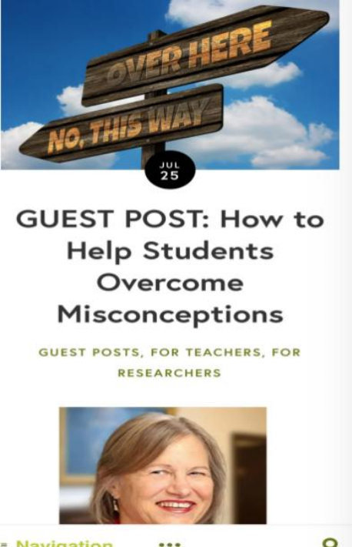
2026年1月浙江首考
①During your initial reading of material, do you ever go back and reread sentences or paragraphs? Is it because the material is too difficult to comprehend on the first reading or because you are asleep? 36 You are napping (打盹) or daydreaming. Halfway down the page you realize that you have no idea what you have read. 37 Thus, you go back and reread, not because you did not understand, but because you were not paying attention. This type of rereading is called regression.
②Napping and daydreaming are habits caused by lack of involvement with the material. Be demanding on yourself and expect 100 percent attention to the task. Engage your mind. Visualize the incoming ideas, and relate the new material to what you already know. 38 If your mind is truly occupied with the text, you will not be able to think about Friday night or where to go on Saturday.
③Regression is a crutch (拐杖) that allows you to make up for wasted time. First of all, become aware of when and why you are regressing. 39 Say, “OK. I missed that paragraph because I was thinking of something else, but I’m going to keep on going and start paying close attention.”
④ 40 Good readers who monitor their own comprehension use it in the reading process. However, regressing because your mind was asleep is a waste of time.
Genre(体裁):
___________
Main Idea/Topic:
________________
Passage Structure:
________________
Para.1 Introduction:Regression
Expository
Regression
Para.2 Cause & Solution
Problem-solution
Para.3 Consequence & Solution
Para.4 Conclusion

Slide 22
Try to anlyze the paragraph structure!
Para.1
① phenomenon/problem: ________
↓
② Question:two possible_______
↓
③ ④ the reason isnapping
↓
⑤_________of napping
↓
⑥______________________
↓
⑦ ______on reading：reread
↓
⑧ Definition of regression
Para.1 ①During your initial reading of material, do you ever go back and reread sentences or paragraphs? ② Is it because the material is too difficult to comprehend on the first reading or because you are asleep? ③Probably, the latter is true.④You are napping (打盹) or daydreaming. ⑤Halfway down the page you realize that you have no idea what you have read.⑥____________37____ ⑦Thus, you go back and reread, not because you did not understand, but because you were not paying attention. ⑧This type of
rereading is called regression.
Notes:
一起回答

Slide 23
Para.1
① phenomenon/problem:reread
↓
② Question:two possible reasons
↓
③ ④ napping is the reason
↓
⑤Consequence of napping
↓
⑥______________________
↓
⑦ Effects on reading:reread
↓
⑧ Definition of regression
Try to anlyze the paragraph structure!
Para.1 ①During your initial reading of material, do you ever go back and reread sentences or paragraphs? ② Is it because the material is too difficult to comprehend on the first reading or because you are asleep? ③Probably, the latter is true. ④You are napping (打盹) or daydreaming. ⑤Halfway down the page you realize that you have no idea what you have read.⑥________________ ⑦Thus, you go back and reread, not because you did not understand, but because you were not paying attention. ⑧This type of
rereading is called regression.
Notes:
一起回答

Slide 24
Try to anlyze the flow connection and make predictions!
Para.1 ①During your initial reading of material, do you ever go back and reread sentences or paragraphs? ② Is it because the material is too difficult to comprehend on the first reading or because you are asleep? ③Probably, the latter is true. ④You are napping (打盹) or daydreaming. ⑤Halfway down the page you realize that you have no idea what you have read.⑥________________ ⑦Thus, you go back and reread, not because you did not understand, but because you were not paying attention. ⑧This type of rereading is called regression.
① phenomenon:reread
↓
② Question:two possible reasons
↓
③ ④ the reason is napping
↓
⑤Consequence of napping
↓
⑥______________________
↓
⑦ Effects on reading:reread
↓
⑧ Definition of regression
explanation解释关系
Prediction:another consequence of napping
cause&effect因果关系
Notes:
一起回答

Slide 25
Let’s compare the options and make the choice!
Para.1 ①During your initial reading of material, do you ever go back and reread sentences or paragraphs? ② Is it because the material is too difficult to comprehend on the first reading or because you are asleep? ③Probably, the latter is true. ④You are napping (打盹) or daydreaming. ⑤Halfway down the page you realize that you have no idea what you have read.⑥________________ ⑦Thus, you go back and reread, not because you did not understand, but because you were not paying attention. ⑧This type of rereading is called regression.
C. Don’t just read the words; think the ideas.
E. Your eyes were engaged, but your mind was not.
Prediction:another consequence of napping
Notes:
一起回答

Slide 26
Self-reflection-Compare the two approaches
Passage Structure
Blanks scan
It’s slow but gives the whole picture and better accuracy.
Paragraph Structure
Clues search
Flow Analysis
Blank Prediction
Options comparison
Option Comparison
Choice made
It’s quick but the answer is not always right.
Choice Made

Slide 27
Tips for the Gap-filling Task
Apply effective approaches to solve the problems.
Don’t jump to blanks directly. Scan the passage first.
Analyze paragraph structure and flow for difficult blanks.
Pay attention to the clues in the text and the options.
and more from your hands-on experience…

Slide 28
Part4 Practice based on Text Awareness
2024年新课标Ⅱ卷
Overtourism Is For Real: How Can You Help?
Travel promotes understanding, expands our minds, makes us better people, and boosts local economies and communities, but the rapid growth of travel has led to overtourism in certain regions and destinations. 36 Certainly not. The loss of what travel offers would be unacceptable in today’s world. Here are some tips on making wise decisions to minimize pressure on the places we visit and improve our experience.
•Choose mindfully. Overvisited destinations are that way for a reason: they’re special. With so many online posts featuring the same places, it’s easy to feel like you’re missing out. Go somewhere only when the landscape, culture or food deeply draws you. 37
•Get creative. The best way to ease pressure on over-touristed destinations is to go somewhere else. Though overtourism is described as a problem affecting the entire world, it’s actually concentrated to a small number of extremely popular spots. That means you have tons of less-visited options to choose from. 38 Why not try a regional alternative or check out a popular destination’s lesser-known sights?
• 39 Minimize impact and maximize experience by skipping major holidays or rush hour. You’ll compete with fewer tourists, save money, experience a different side of a popular place, and boost the economy when tourism is traditionally slower.
Visiting a place that others call home is a privilege (荣幸). Do your part to preserve what makes a destination special in the first place. 40 You may be amazed how much closer you’ll feel to the people there.
A. Visit during off-peak times.
B. So, should we stop traveling?
C. Travel for you and no one else.
D. Can overtourism be avoided then?
E. You can still find relatively undiscovered places.
F. You’ll find yourself virtually alone, or close to it.
G. Consider giving back to the communities you’re visiting.
Analyze the Passage(1 min)
Notes:
数据 – 核心问题 – 缺乏对语篇的关注的问题 – AI提出重点 – 总结策略 –
分析structure and flow 和其他的
一个整篇做
让AI再来讲一下 其中一个题 看看谁讲得更好

Slide 29
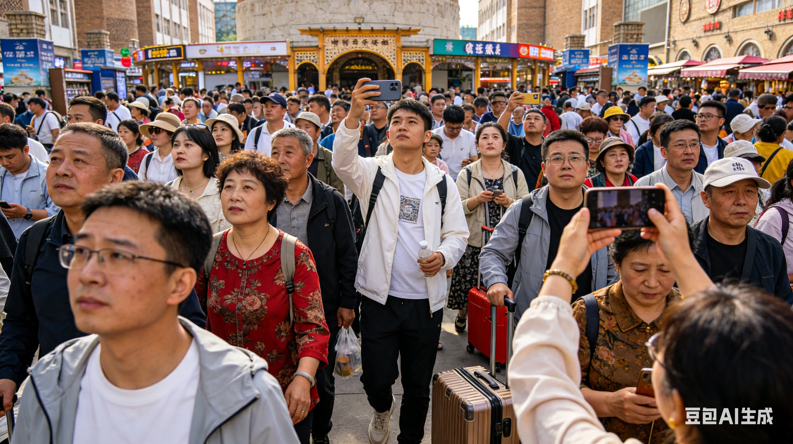
2024年新课标Ⅱ卷
Overtourism Is For Real: How Can You Help?
Travel promotes understanding, expands our minds, makes us better people, and boosts local economies and communities, but the rapid growth of travel has led to overtourism in certain regions and destinations. 36 Certainly not. The loss of what travel offers would be unacceptable in today’s world. Here are some tips on making wise decisions to minimize pressure on the places we visit and improve our experience.
•Choose mindfully. Overvisited destinations are that way for a reason: they’re special. With so many online posts featuring the same places, it’s easy to feel like you’re missing out. Go somewhere only when the landscape, culture or food deeply draws you. 37
•Get creative. The best way to ease pressure on over-touristed destinations is to go somewhere else. Though overtourism is described as a problem affecting the entire world, it’s actually concentrated to a small number of extremely popular spots. That means you have tons of less-visited options to choose from. 38 Why not try a regional alternative or check out a popular destination’s lesser-known sights?
• 39 Minimize impact and maximize experience by skipping major holidays or rush hour. You’ll compete with fewer tourists, save money, experience a different side of a popular place, and boost the economy when tourism is traditionally slower.
Visiting a place that others call home is a privilege (荣幸). Do your part to preserve what makes a destination special in the first place. 40 You may be amazed how much closer you’ll feel to the people there.
Genre(体裁):
___________
Main Idea/Topic:
_______________
Passage Structure:
________________
Para.1 Introduction:Tips on wise travel
Expository
Tips on wise travel
Para.2 Tip1: Choose what you like
General-specific
Para.3 Tip2: Try less-known sights
Para.4 Tip3: Skip holidays or rush hour
Para.5 Conclusion

Slide 30
Part4 Practice based on Text Awareness
2024年新课标Ⅱ卷
Overtourism Is For Real: How Can You Help?
Travel promotes understanding, expands our minds, makes us better people, and boosts local economies and communities, but the rapid growth of travel has led to overtourism in certain regions and destinations. 36 Certainly not. The loss of what travel offers would be unacceptable in today’s world. Here are some tips on making wise decisions to minimize pressure on the places we visit and improve our experience.
•Choose mindfully. Overvisited destinations are that way for a reason: they’re special. With so many online posts featuring the same places, it’s easy to feel like you’re missing out. Go somewhere only when the landscape, culture or food deeply draws you. 37
•Get creative. The best way to ease pressure on over-touristed destinations is to go somewhere else. Though overtourism is described as a problem affecting the entire world, it’s actually concentrated to a small number of extremely popular spots. That means you have tons of less-visited options to choose from. 38 Why not try a regional alternative or check out a popular destination’s lesser-known sights?
• 39 Minimize impact and maximize experience by skipping major holidays or rush hour. You’ll compete with fewer tourists, save money, experience a different side of a popular place, and boost the economy when tourism is traditionally slower.
Visiting a place that others call home is a privilege (荣幸). Do your part to preserve what makes a destination special in the first place. 40 You may be amazed how much closer you’ll feel to the people there.
A. Visit during off-peak times.
B. So, should we stop traveling?
C. Travel for you and no one else.
D. Can overtourism be avoided then?
E. You can still find relatively undiscovered places.
F. You’ll find yourself virtually alone, or close to it.
G. Consider giving back to the communities you’re visiting.
2. Fill in the Gaps(7 min)
Notes:
数据 – 核心问题 – 缺乏对语篇的关注的问题 – AI提出重点 – 总结策略 –
分析structure and flow 和其他的
一个整篇做
让AI再来讲一下 其中一个题 看看谁讲得更好

Slide 31
Anlyze the Paragraph Structure
Para.1 ①Travel promotes understanding, expands our minds, makes us better people, and boosts local economies and communities, but the rapid growth of travel has led to overtourism in certain regions and destinations.② ________ ③Certainly not. ④The loss of what travel offers would be unacceptable in today’s world. ⑤ Here are some tips on making wise decisions to minimize pressure on the places we visit and improve our experience.
①___________________
↓
② ___________________
↓
③ ___________________
↓
④ ___________________
↓
⑤____________________
Notes:
一起回答

Slide 32
Part4 Practice based on Text Awareness
2024年新课标Ⅱ卷
Overtourism Is For Real: How Can You Help?
Travel promotes understanding, expands our minds, makes us better people, and boosts local economies and communities, but the rapid growth of travel has led to overtourism in certain regions and destinations. 36 Certainly not. The loss of what travel offers would be unacceptable in today’s world. Here are some tips on making wise decisions to minimize pressure on the places we visit and improve our experience.
•Choose mindfully. Overvisited destinations are that way for a reason: they’re special. With so many online posts featuring the same places, it’s easy to feel like you’re missing out. Go somewhere only when the landscape, culture or food deeply draws you. 37
•Get creative. The best way to ease pressure on over-touristed destinations is to go somewhere else. Though overtourism is described as a problem affecting the entire world, it’s actually concentrated to a small number of extremely popular spots. That means you have tons of less-visited options to choose from. 38 Why not try a regional alternative or check out a popular destination’s lesser-known sights?
• 39 Minimize impact and maximize experience by skipping major holidays or rush hour. You’ll compete with fewer tourists, save money, experience a different side of a popular place, and boost the economy when tourism is traditionally slower.
Visiting a place that others call home is a privilege (荣幸). Do your part to preserve what makes a destination special in the first place. 40 You may be amazed how much closer you’ll feel to the people there.
A. Visit during off-peak times.
B. So, should we stop traveling?
C. Travel for you and no one else.
D. Can overtourism be avoided then?
E. You can still find relatively undiscovered places.
F. You’ll find yourself virtually alone, or close to it.
G. Consider giving back to the communities you’re visiting.
Key:
36.B 37.C 38.E 39.A 40.G
Notes:
数据 – 核心问题 – 缺乏对语篇的关注的问题 – AI提出重点 – 总结策略 –
分析structure and flow 和其他的
一个整篇做
让AI再来讲一下 其中一个题 看看谁讲得更好

Slide 33
Anlyze the Paragraph Structure
Para.1 ①Travel promotes understanding, expands our minds, makes us better people, and boosts local economies and communities, but the rapid growth of travel has led to overtourism in certain regions and destinations.② ________ ③Certainly not. ④The loss of what travel offers would be unacceptable in today’s world. ⑤ Here are some tips on making wise decisions to minimize pressure on the places we visit and improve our experience.
①___________________
↓
② ___________________
↓
③ ___________________
↓
④ ___________________
↓
⑤____________________
Notes:
一起回答

Slide 34


Self-Assessment
 | I know the clear steps to deal with the gap-filling tasks.
 | I know how to analyze: - passage structure; - paragraph structure; - the flow between sentences;
 | I know how to make predictions based on the analysis above.
 | I know how to compare the options and find the best answer.

Slide 35
Homework
2025年新课标Ⅱ卷
Unexpected Benefits of Volunteering as a Family
Are you looking for a way to bring your family together? Hoping to find a hobby that can be shared by both the little ones and adults? ___36___ You may know the “feel-good” emotions that come with helping others, but there are even more unexpected ways volunteering will positively affect the whole family.
●You’ll feel like you have more time.
People often feel they are too busy to volunteer. Yet, research has found that giving your time to community causes actually makes you feel like you have more of it. ___37___
●You can live longer if you volunteer regularly.
___38___ Washington University found that adults 55 and older who volunteered had better memory and maintained overall health longer than others their age Volunteers are also more likely to look after their own health and are more focused on adding physical activity into their lives.
● ___39___
Volunteering during teenage years has been linked to some major positive effects such as improved grades and increased self-confidence. These effects aren’t just short-term but have been proved to affect a teen’s well-being in the years to come.
●You’ll have more time with family.
Families who volunteer together have the unique experience of working toward a common goal. ___40___ Everyone brings something unique to the table and can connect with each other in a new way. And, there are tasks for every age and ability, so all your children can feel proud of their work.
A. Helping the community lowers rates of depression.
B. Volunteering as a family may be just the thing you need.
C. Volunteering has a lifelong effect on kids and teenagers.
D. Volunteering can be the first step in breaking down prejudice.
E. For adults, volunteering can provide significant physical health benefits.
F. You may even learn that your kid has a talent you didn’t know about before.
G. Volunteering makes you feel capable and inspires you to make the most of each day.
Notes:
数据 – 核心问题 – 缺乏对语篇的关注的问题 – AI提出重点 – 总结策略 –
分析structure and flow 和其他的
一个整篇做
让AI再来讲一下 其中一个题 看看谁讲得更好

Slide 36
Thank you for
your attention!

